Slide 1

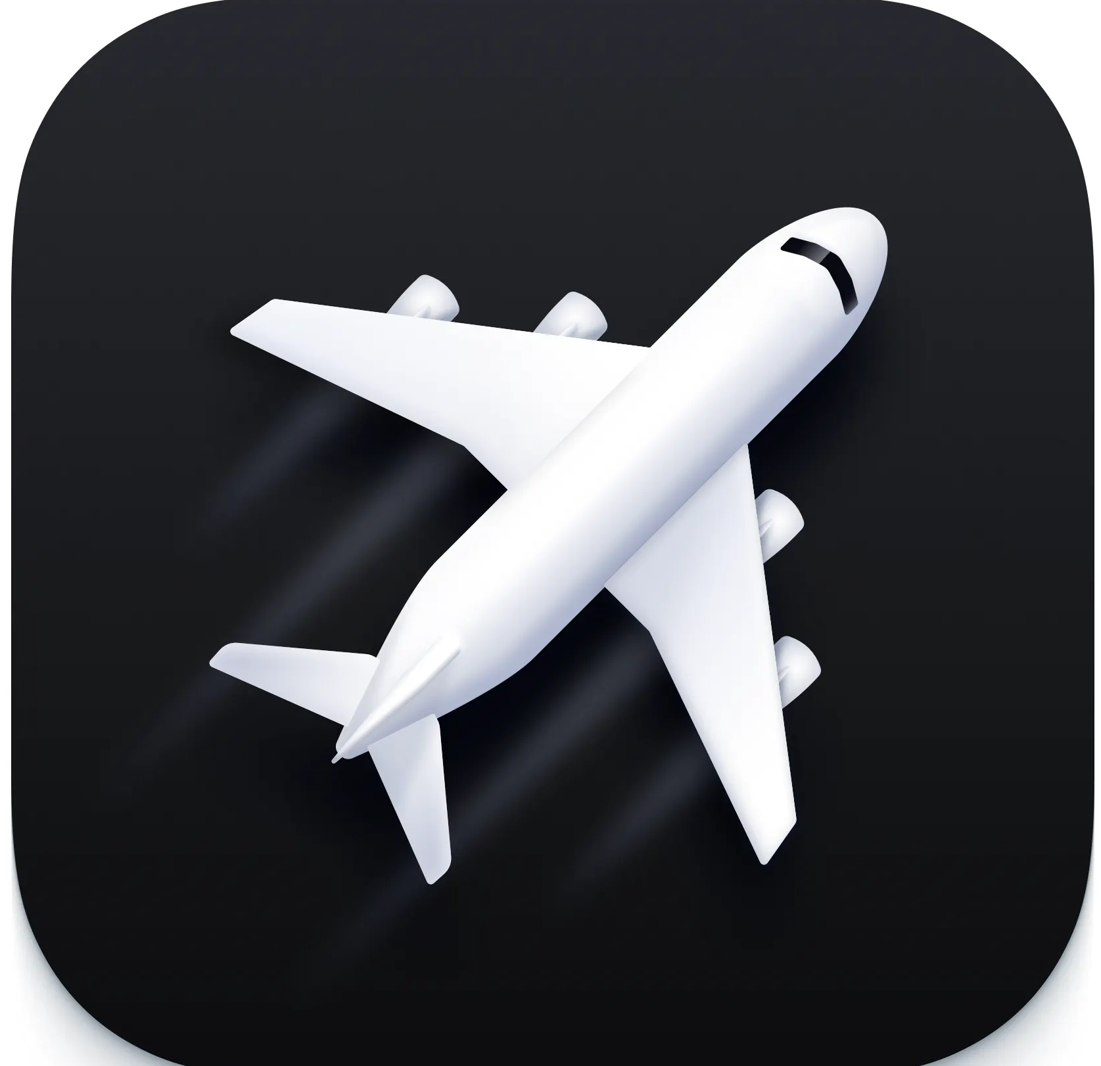
Flight Price Tracker
A Flutter-Based Flights Offer Tracking App with Real-Time Price Updates
By
Gowtham M
TechMahindra Batch 1

Slide 2
🛫 Introduction to Flight Price Tracker
Flight prices fluctuate frequently, making it challenging for travelers to find the best deals.
Our Flight Price Tracker helps users monitor flight prices in real-time and receive updates on changes.
It provides essential flight details such as departure, arrival, duration, baggage allowance, and cancellation policies.
The app fetches data dynamically from Firebase and Amadeus API to keep the information updated.
Goal: To make flight booking easier and more cost-effective by providing real-time price insights.

Slide 3
Key Features
Flutter-powered App: Built using Flutter for a smooth, cross-platform experience on Android & iOS.
Real-time Flight Data: Fetches up-to-date flight prices and details from Amadeus API and stores user preferences in Firebase.
User-friendly Interface: Intuitive and easy-to-navigate UI for seamless tracking.
Multi-language Support: Supports multiple languages using Easy Localization for a global audience.
Flight Details Page: Displays flight duration, baggage allowance, layovers, airline, and cancellation policies.
Saved Flights: Users can save flights to track price changes over time.
Secure and Reliable: Data is securely stored and fetched using Firebase for real-time updates.

Slide 4
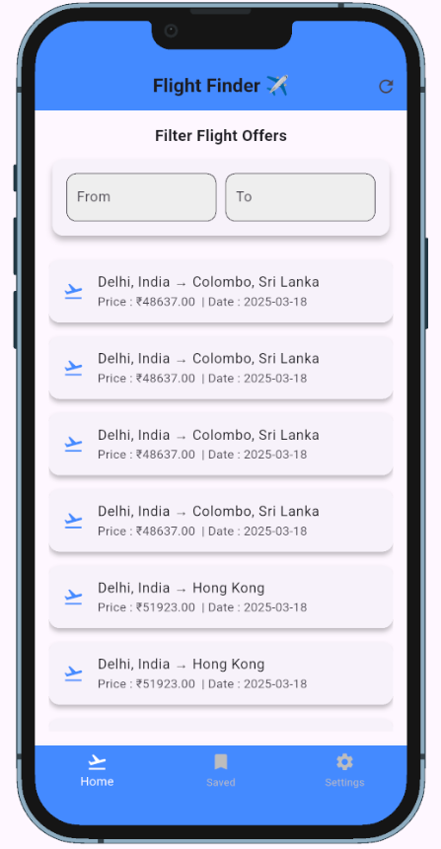
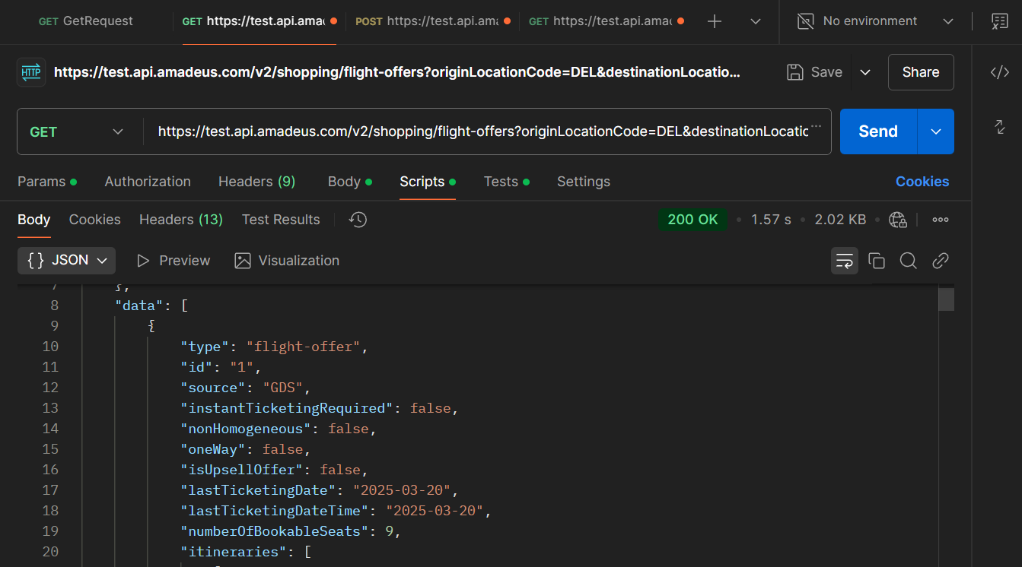
Work Flow of Flight Price Tracker App
1) Loading Data (App Startup)
The app fetches real-time flight data from Amadeus API when launched (Tested Using Postman).
The fetched data is displayed dynamically on the UI
Screenshots

Slide 5
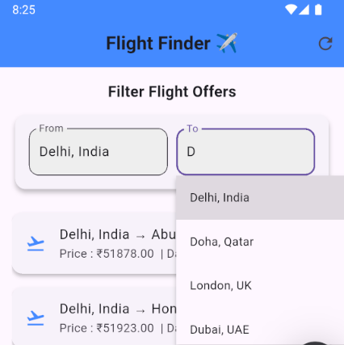
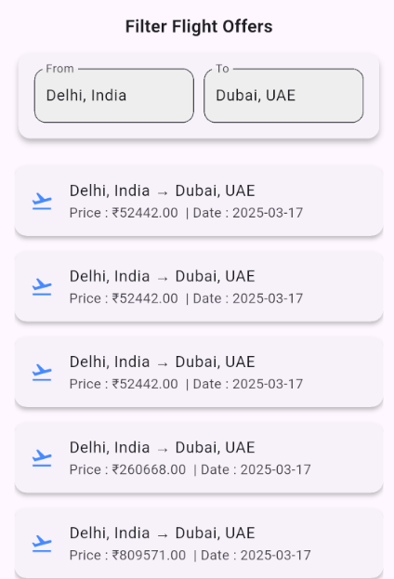

2) Applying Filters
Users refine search results using filters (Origin and Destination Locations)
The app dynamically updates the displayed flights based on selected filters.
Added Feature: Suggestions for input fields to enhance user experience.

Slide 6
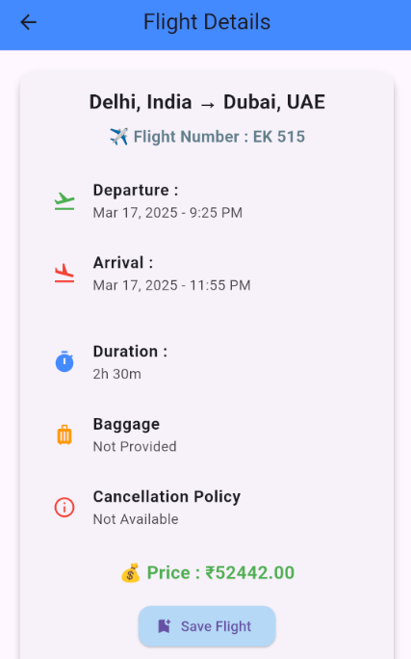
3) Displaying Flight Details ✈️
Users select a flight to view full details (price, duration, baggage, etc.).
Flight details are formatted for easy comparison.

Slide 7

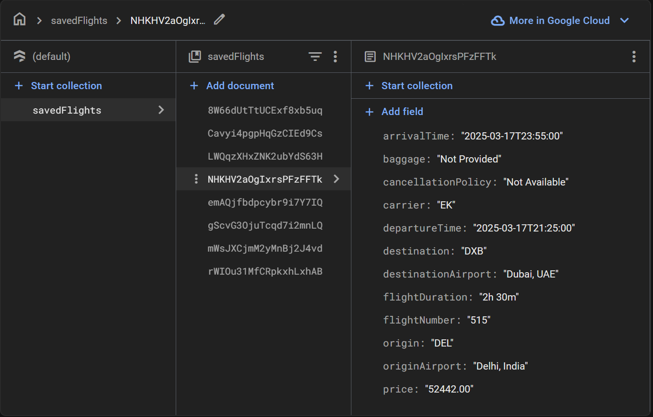

4) Saving Flights to Firebase
Users can save selected flights for future reference.
Saved flights are securely stored in Firebase for quick access

Slide 8
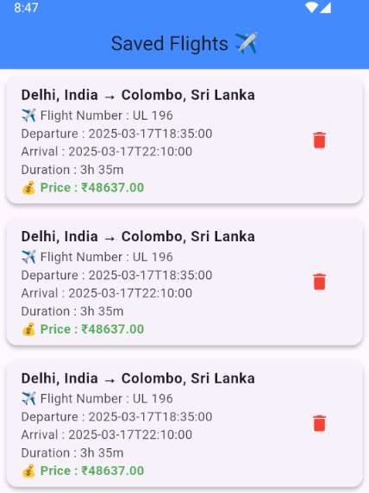
5) Viewing Saved Flights
Users can access and manage their saved flights from a dedicated page.
Helps in tracking price changes over time.

Slide 9
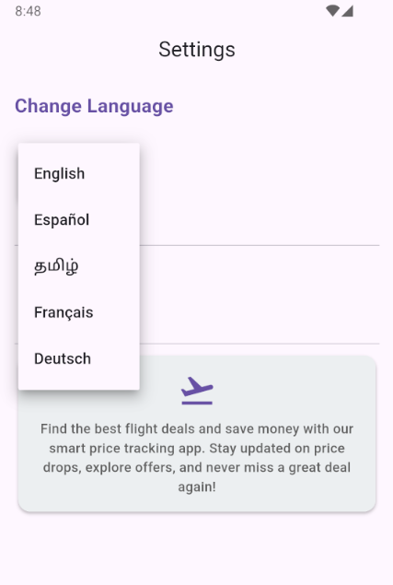
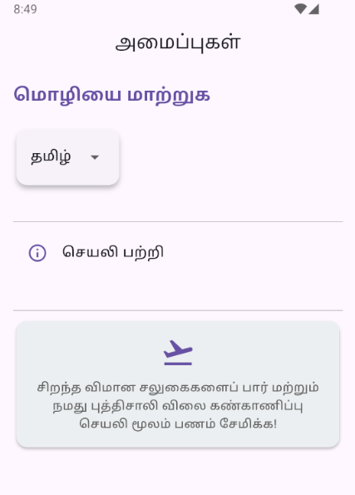
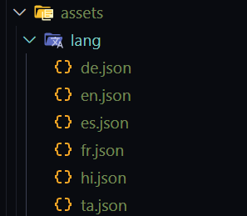
6) Multi-language Support
The app supports multiple languages (English, Tamil, Hindi, German, Spanish).
Translations are managed via localization JSON files.

Slide 10
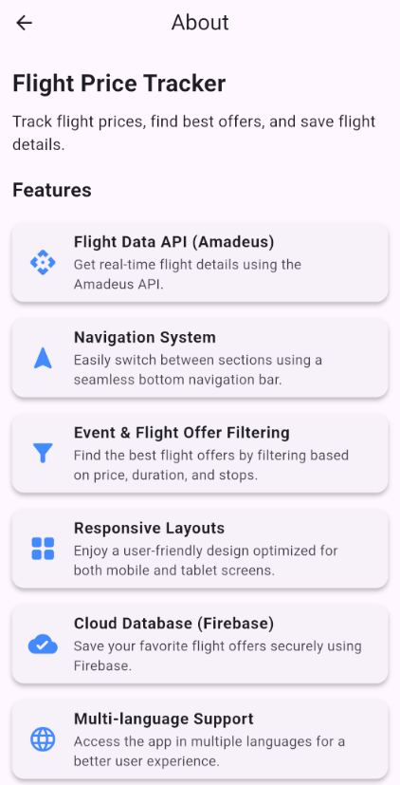
7) About Page
The About Page provides an overview of the Flight Price Tracker app.
This page helps users understand the functionality and benefits of the app.

Slide 11
Flutter Concepts Used
State Management – Efficiently handles dynamic UI updates using Provider or SetState()
Networking & API Integration – Fetches real-time flight data from Amadeus API using Http Package
Firebase Integration – Uses Firebase Firestore for saving favorite flights and user preferences.
Localization & Multi-Language Support – Implements easy_localizationto support multiple languages.
Responsive UI Design – Utilizes MeidaQuery and LayoutBuilder for optimal experience across devices.
Navigation & Routing – Manages screen transitions using Navigator and OnGenerateRoute.
Form Validation & User Input Handling – Ensures valid searches usingTextFromField and Form Widgets

Slide 12
Thank you
Gowtham M
TechMahindra Training Batch 1 (2025)
gowthamudpm2004@gmail.com

